Slide 1

Introduction to Data Analysis in R
BIOL90041
Week 2
Dr. Kristoffer Wild

Slide 2
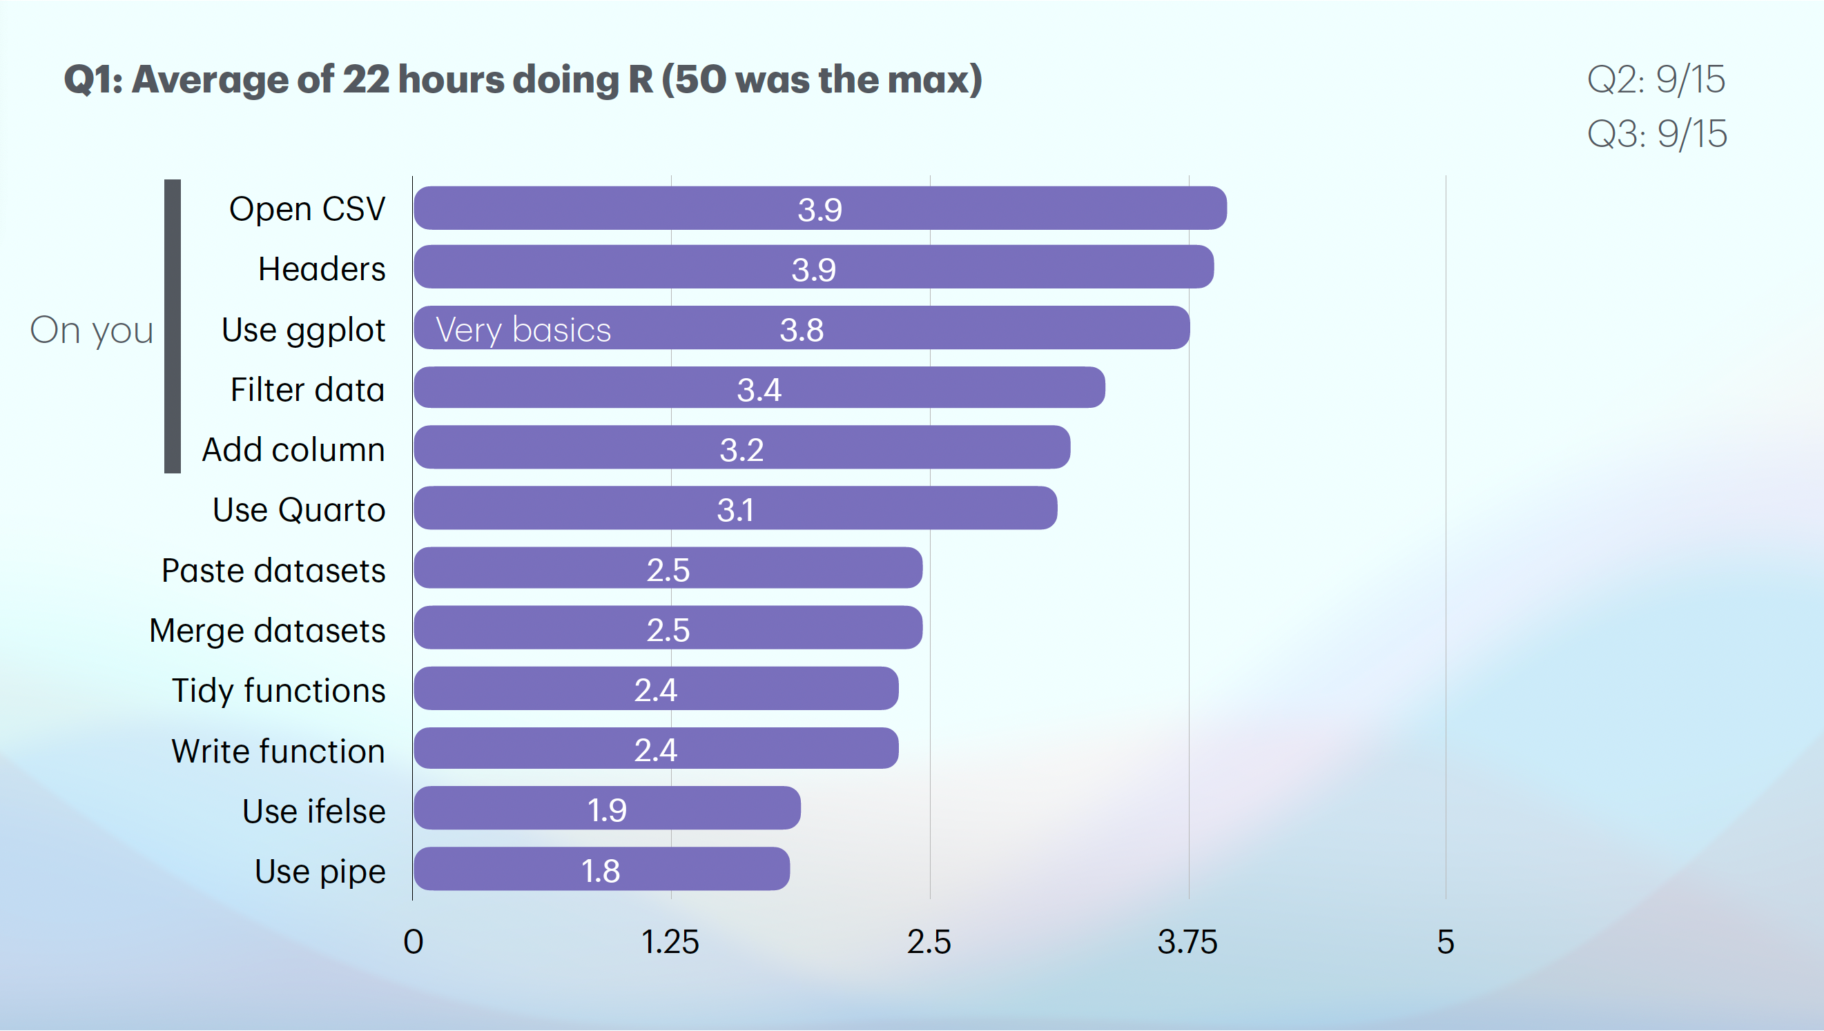
Notes:
If you’re like most students, you feel so much pressure trying to instantly understand R, while staring up at the steep and dreaded learning curve to do so.
I totally get it. And I can help.
After struggling with it myself, I actually came to love R.
Yep, I did.
See, R translates numbers into meaning, and allows you to handle your own data.

Slide 3



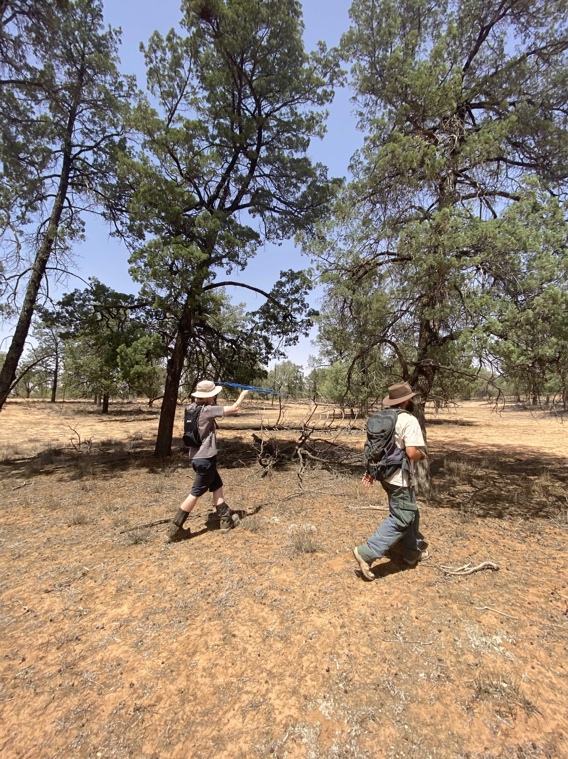
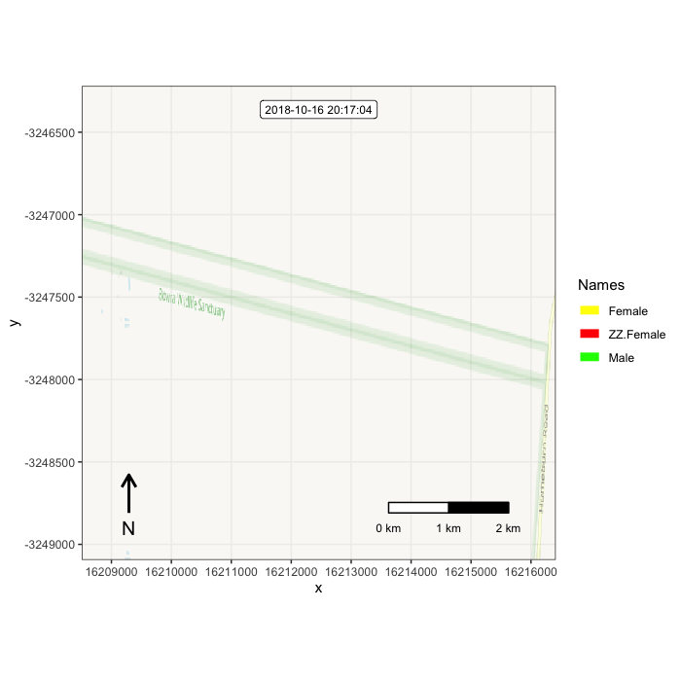

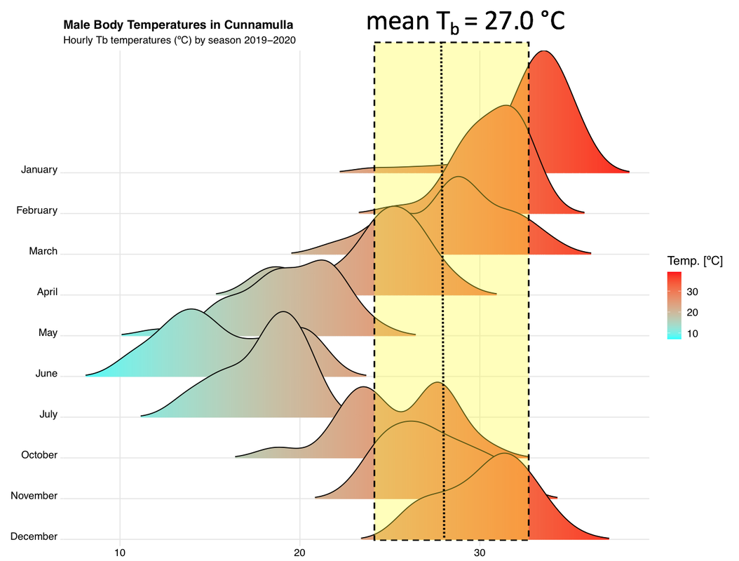
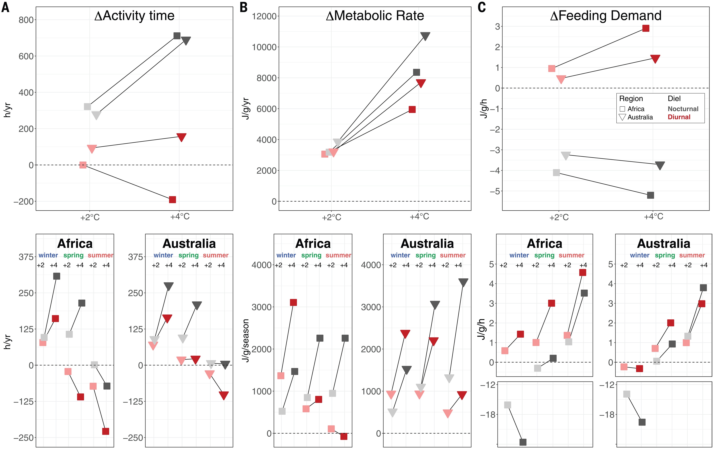
Kristoffer Wild
kristofferw@unimelb.edu.au
kwildresearch.com

Slide 4
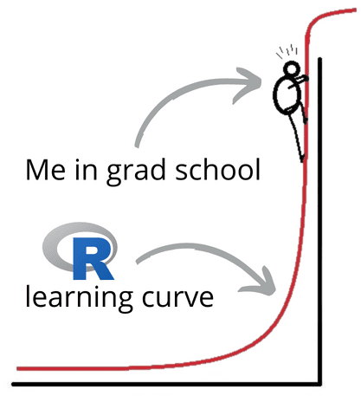
Notes:
If you’re like most students, you feel so much pressure trying to instantly understand R, while staring up at the steep and dreaded learning curve to do so.
I totally get it. And I can help.
After struggling with it myself, I actually came to love R.
Yep, I did.
See, R translates numbers into meaning, and allows you to handle your own data.

Slide 5
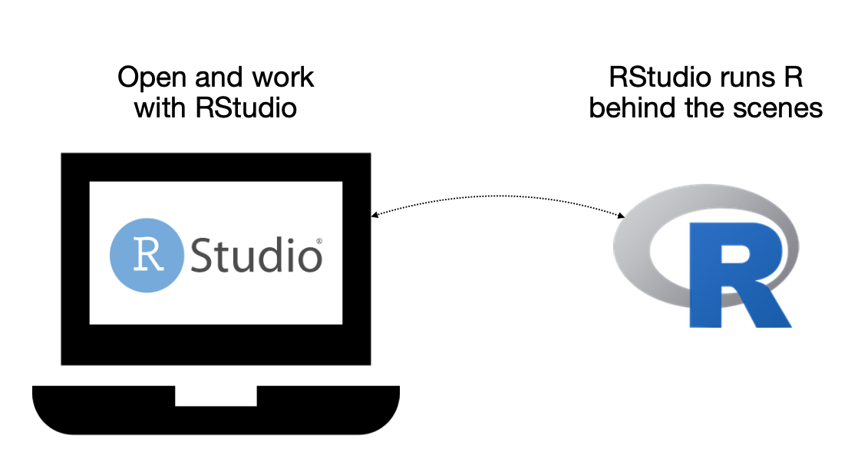

Learning objectives
Get familiar with R….
how to download R and R studio
setting up R studio
basic R functions
data types in R
installing a package
Working with dplyr
understanding a data frame
working with the common ‘verbs’

Slide 6
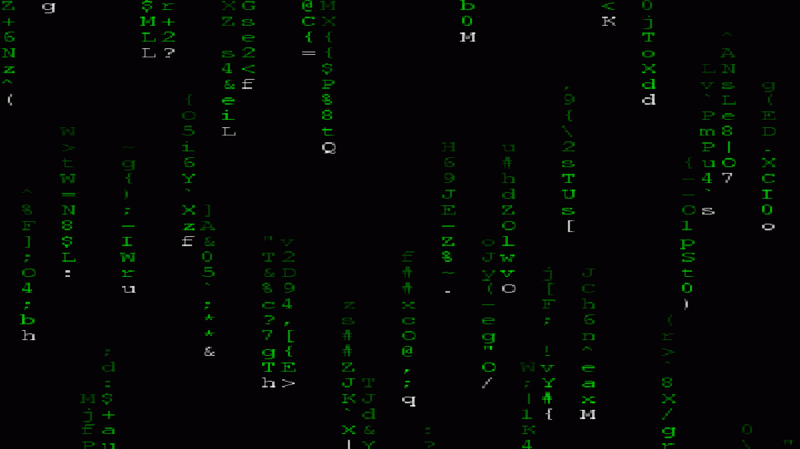
Today’s presentation
Introduction to R Programming Language
Structure of R
Installation and set-up
Data-types in R
Working with dplyr

Slide 7

1. Introduction to R Programming Language
R is a computing language that first appeared in the 1990s (c.1993)
Originally developed at the University of Auckland, New Zealand
Intended use was for performing statistics and generating graphics
Use now extends to many other areas:
DNA arrays
Gene expression arrays
RNA-seq analysis
Predecessor to R was S Programming Language, developed at Bell Laboratories in 1970s
R has come to be one of the primary computing languages used in bioinformatics

Slide 8

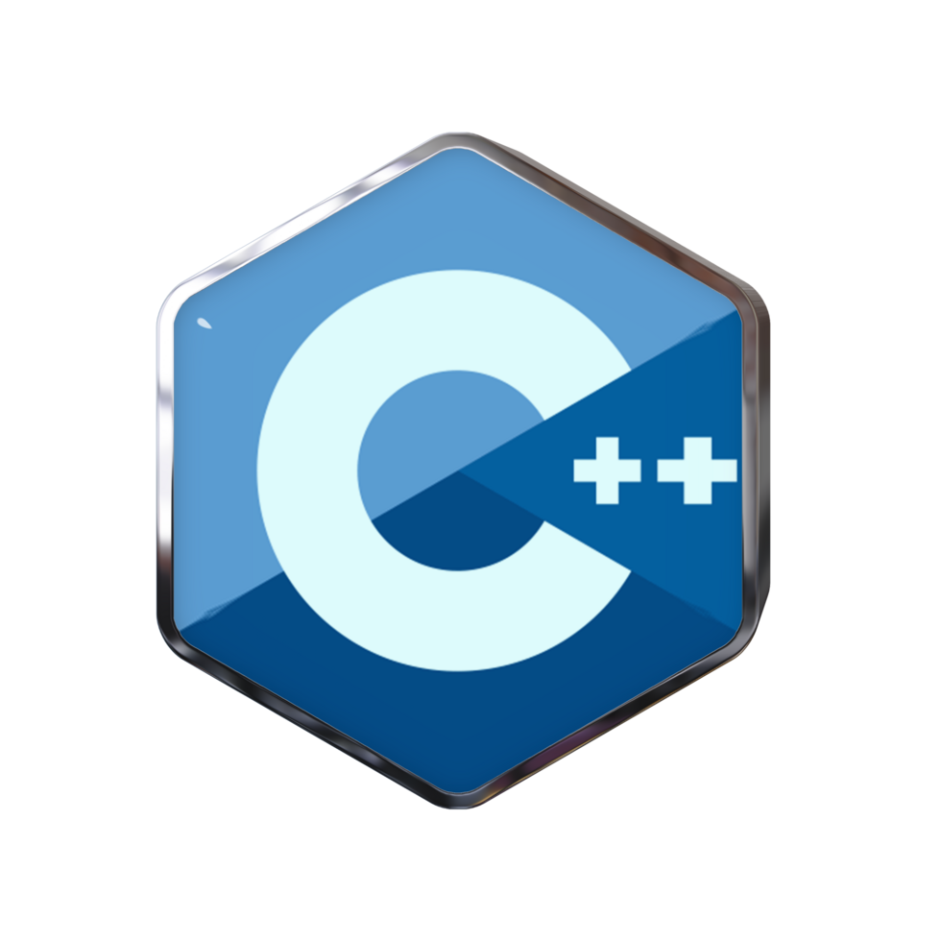
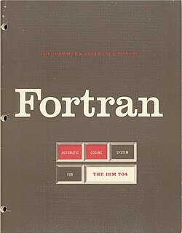
1. Introduction to R Programming Language
R is fundamentally a 'scripting' language, not a high-end programming language
Therefore it is limited in what it can do
High-end programming languages include C, C++, JAVA, Fortran
- these can be used to build complex, mainstream computer applications
R is mainly for short programs that are interpreted in a batch-like (sequential) manner
R was created using C and Fortran code
In this lecture, code that you are expected to type is coloured red and ‘have #s above it!’

Slide 9

Today’s presentation
Introduction to R Programming Language
Structure of R
Installation and set-up
Data-types in R
Working with dplyr

Slide 10

2. Structure of R
The R environment is comprised of 'packages' (1,000s)
Packages are stored on the World Wide Web in repositories like CRAN (Comprehensive R Archive Network) and Bioconductor
A package can be thought as a set of functions that perform related tasks
dplyr popular data manipulation library
stringr For string manipulation.
ggplot2 package provides many graphical functions
When you first install R, many 'core' packages come bundled with the installation; other packages must be manually added

Slide 11
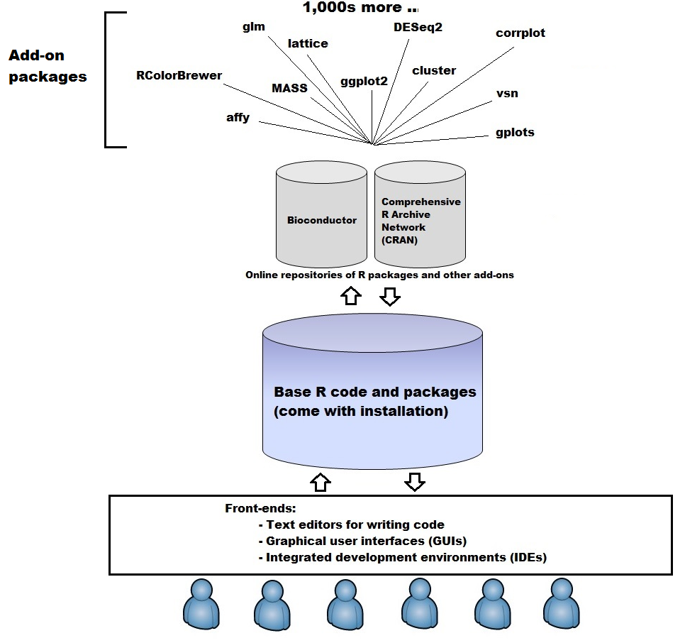

Slide 12
Today’s presentation
Introduction to R Programming Language
Structure of R
Installation and set-up
Data-types in R
Working with dplyr

Slide 13
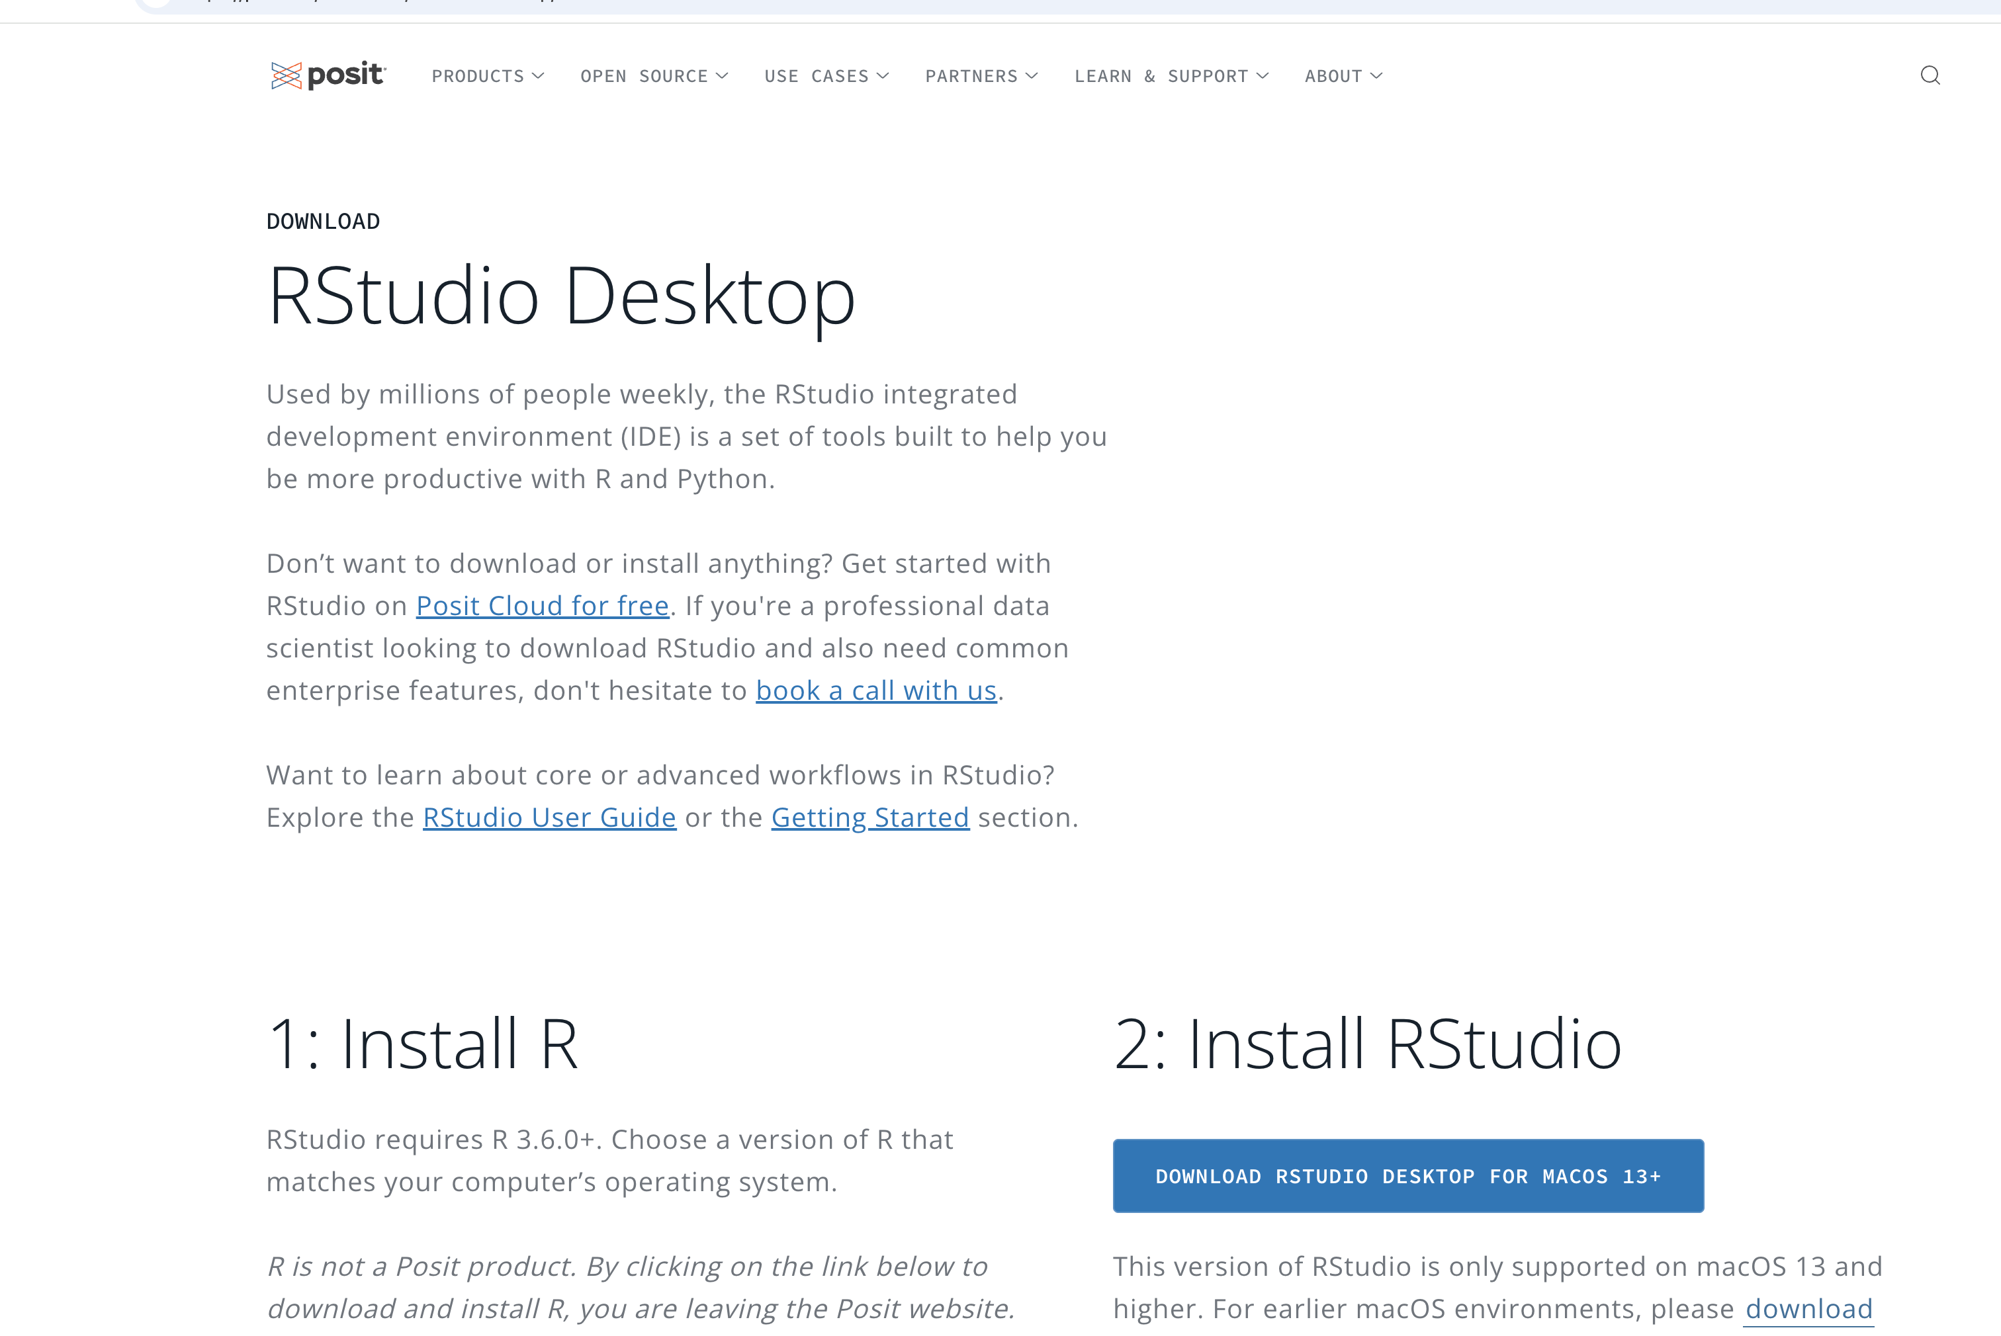
3. Installation and set-up
If you have not already, install R and RStudio on your computer
https://posit.co/download/rstudio-desktop/
Choose any mirror, closer ones will be faster

Slide 14
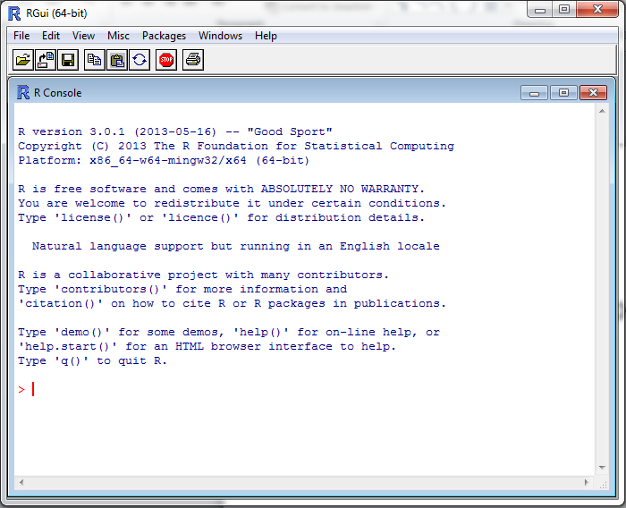

Load up R
Find the standalone R program
Open it
Enter commands at the > sign, e.g.
> 2 + 4
> x <- 7
> x + 19
The > is the R
command prompt
This font means this is an R command

Slide 15
What is R doing?
The [1] means the first element of a vector
Even a single number in R is a vector, so “6” is a vector of size 1
> 2+4
[1] 6
> x <- 7
> x + 19
[1] 26
> X + 10
Error: object 'X' not found
<- means “assign” in this case “assign the value 7 to the variable x”
Some use = for this purpose but it is frowned upon
Adding 19 to x gives the expected value of 26
X is not the same as x
R is case sensitive: upper case letters are different to lower case letters

Slide 16
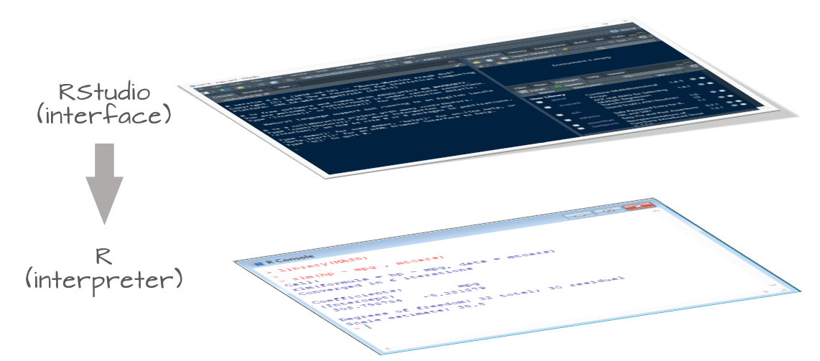
Rstudio: An Integrated Development Environment
It is tedious to write R code in the command line
Old style: create a text file (e.g. Notepad) and copy the code you want to run to the command line
Much better to use RStudio. Why?
Multiple input-output files
View variable values, color coding
Built-in help
Quick running of code
Easy file handling
Easy package installation
Many other reasons

Slide 17
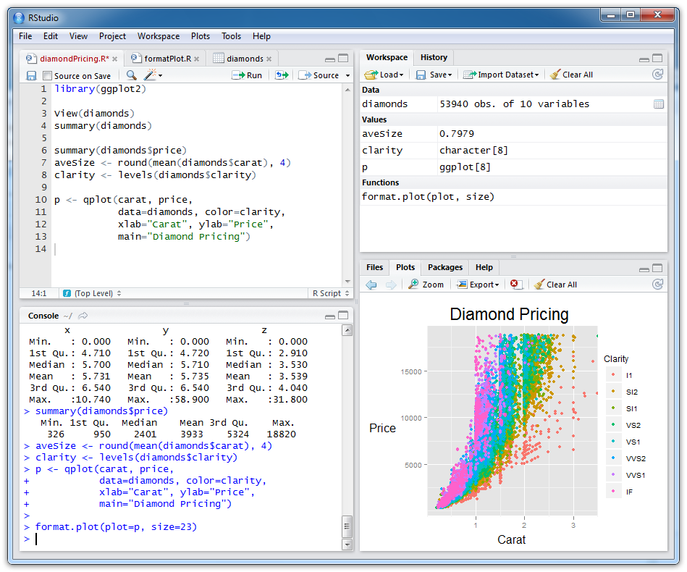
Rstudio: An example
Scripts (files
with R code)
Objects you have created
R console (results from
running R code)
Plots and help

Slide 18
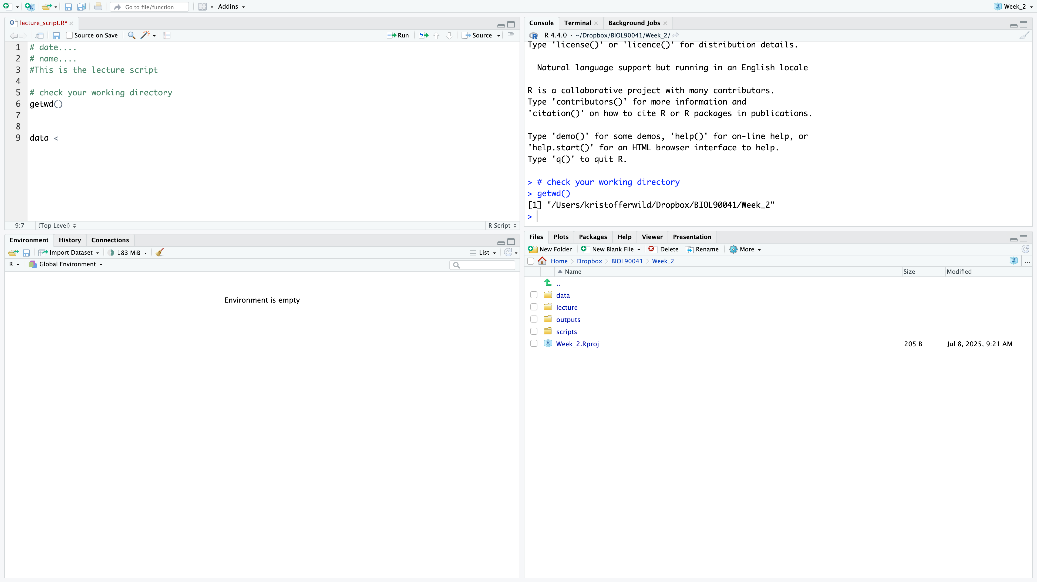
Rstudio: customise

Slide 19
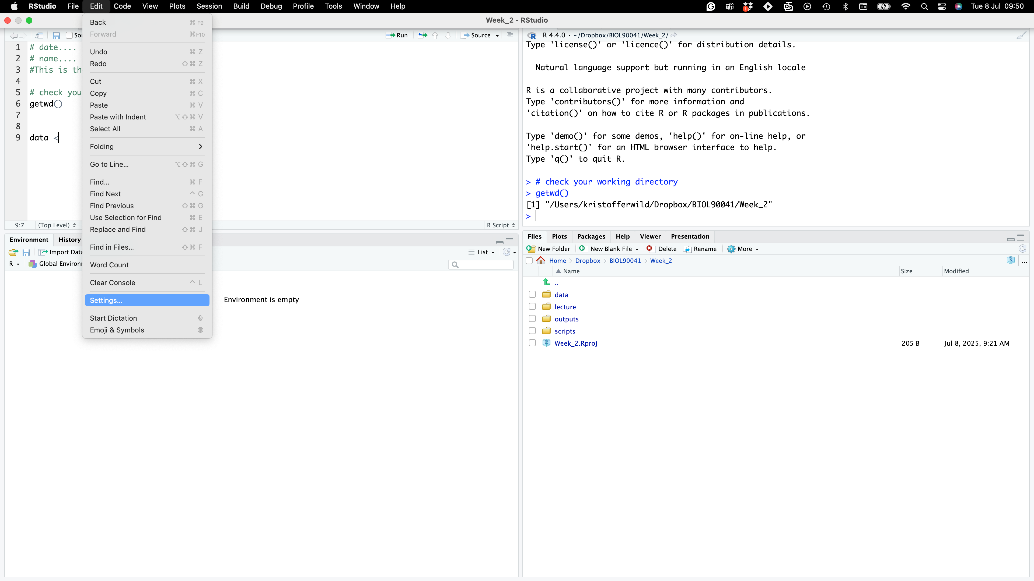
Rstudio: customise

Slide 20
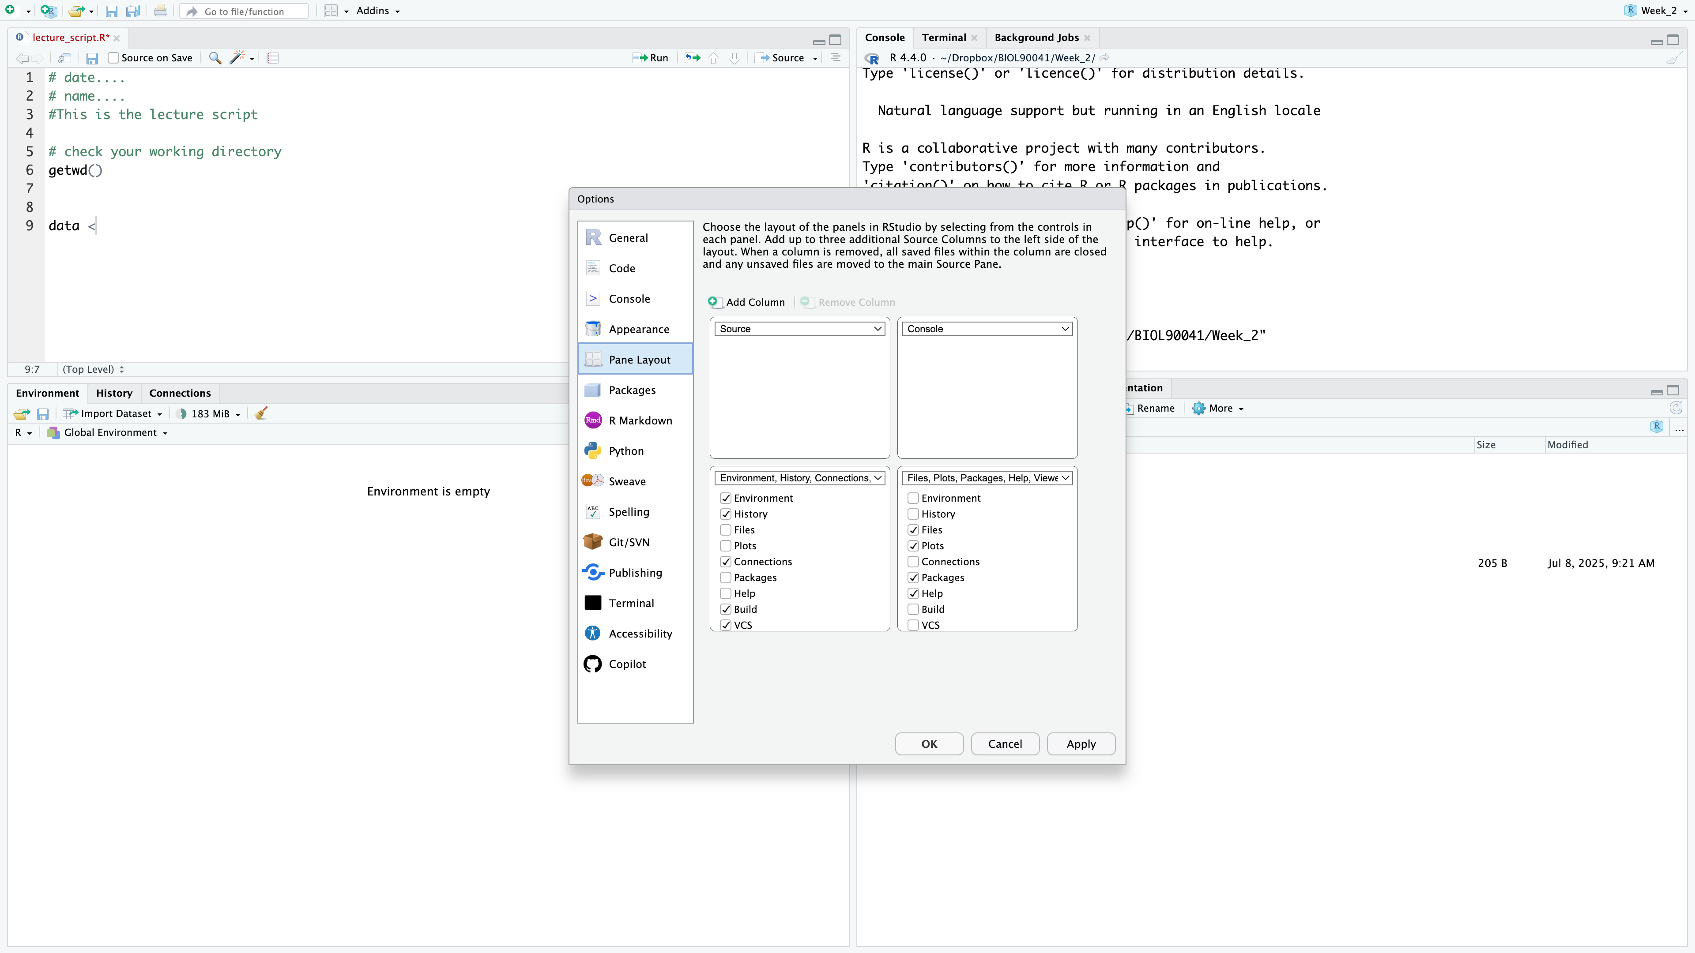
Rstudio: customise
Scripts (files
with R code)
R console (results from
running R code)
Objects you have created
Plots and help

Slide 21
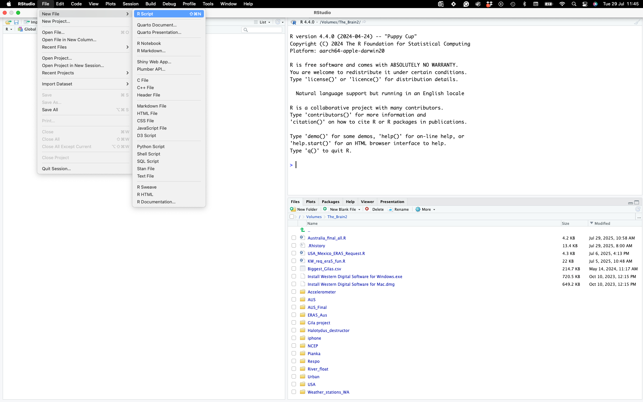
1. Introduction to R Programming Language
Create a script called ‘Lecture2_script.r’
In this lecture, code that you are expected to type is coloured red and ‘have #s above it!’

Slide 22
R scripts
A text file (e.g. Lecture2_script.r) that contains all your R code
It’s a complete record of your analyses
Reproducible: re-running your code is easy for you or someone else
Easily modified and re-run
In Rstudio to run code select code and type…
‘ctrl+enter’ for pc’s (YUCK!)
‘command+enter’ for Macs :D
SAVE YOUR SCRIPTS (unsaved scripts have red title)

Slide 23
Running a simple function
Function Name
Function Argument(s)
sqrt(10)
[1] 3.162278
Notes:
function is a self-contained block of code designed to perform a specific task
functions typically take input data (called arguments or parameters), process it,
and often return a result.
They are fundamental for organizing code, promoting reusability, and improving readability.

Slide 24

Running a simple function
# function self contained block of code,
# within brackets are arguments or parameters
DID YOU COMMENT AND CODE ???
sqrt(10)
[1] 3.162278

Slide 25
Help from within R
#Getting help for a function
> ?log()
> help("log")
Searching across packages
> help.search("logarithm")
Finding all functions of a particular type
> apropos("log")
[7] "SSlogis" "as.data.frame.logical" "as.logical" "as.logical.factor" "dlogis" "is.logical"
[13] "log" "log10" "log1p" "log2" "logLik" "logb"
[19] "logical" "loglin" "plogis" "print.logLik" "qlogis" "rlogis"

Slide 26
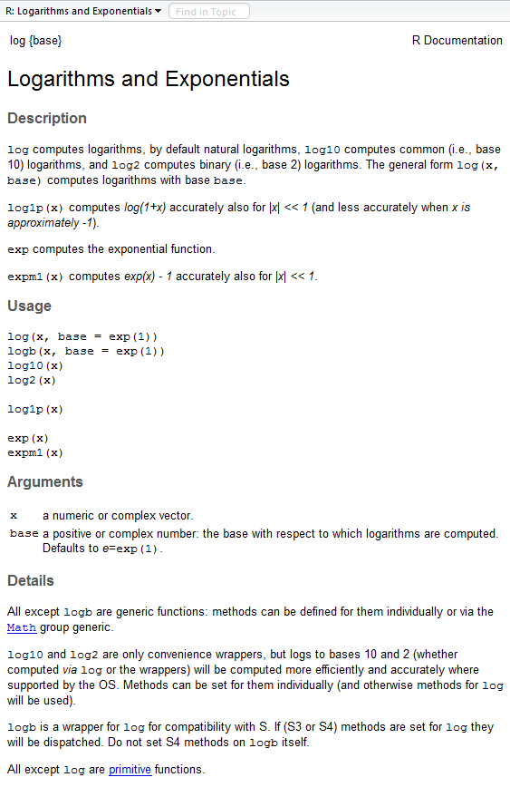
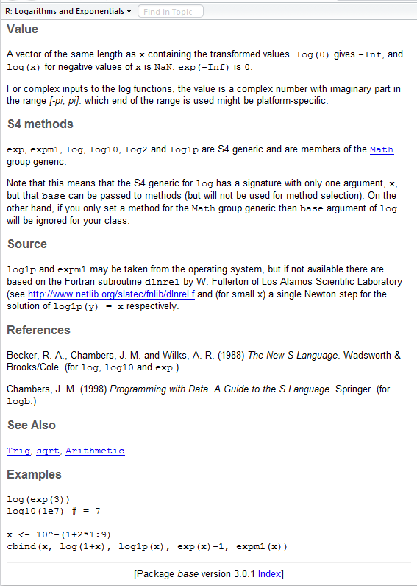
?log
What does the function return
What the function does in general terms
How to use the function
What does the function need
Discover other related functions
Sample code showing how it works

Slide 27
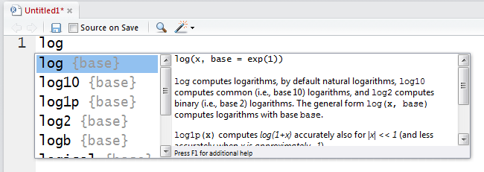
RStudio quick help
Start typing in the Scripts window (top-left)
Press <tab> and a list of available functions starting with those letters appears, plus help
Try typing log( and then pressing <tab>

Slide 28
STOP AND CODE
Say you have this object below
cool_vec <- ‘kris is cool’
Now not knowing the rep() function, figure out how repeat that object 3 times using that function

Slide 29
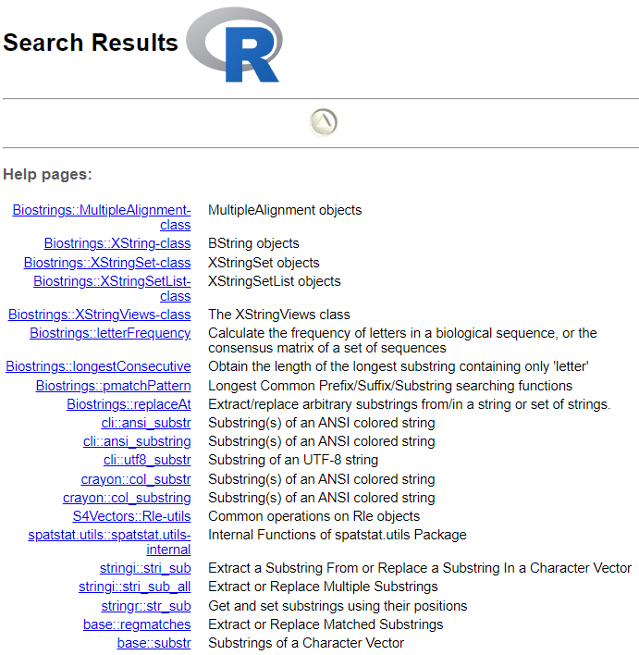
Searching Help
??substring
Package
Function
base::substr
Notes:
Refer to the cheat sheet
Google is also an option.

Slide 30
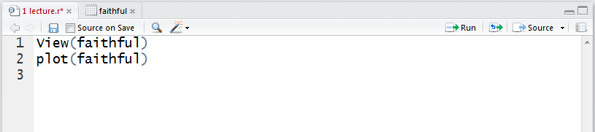
RStudio tips
Sends current line or selection to console (faster to type ctrl+enter)
Sends entire file to R console
Re-send the lines of code you last ran
(useful after edits)

Slide 31
Commenting your code (do it)
Use “comments” to document the intention of your code
Anything on a line after # is ignored by R
# Old Faithful Geyser, Yellowstone NP
plot(faithful)
Rules of thumb
Document the purpose of the code not how it works
Use good variable names
Assume you will remember nothing about the code when you look at it later (next week, year, decade)
RStudio: different color for comments

Slide 32
Some simple R commands
> 2+2
[1] 4
> 3^2
[1] 9
> sqrt(25)
[1] 5
> 2*(1+1)
[1] 4
> 2*1+1
[1] 3
> exp(1)
[1] 2.718282
> log(2.718282)
[1] 1
> log(10, base=10)
[1] 1
> log(10
+ , base = 10
[1] 1
>rep()
Result of the command
Optional argument
Incomplete command
Order of precedence

Slide 33
Frequently used operators
<- | Assign
+ | Sum
- | Difference
* | Multiplication
/ | Division
^ | Exponent
%% | Mod
%*% | Dot product
%/% | Integer division
%in% | Subset
| | Or
& | And
< | Less
> | Greater
<= | Less or =
>= | Greater or =
! | Not
!= | Not equal
== | Is equal

Slide 34
R workspaces
When you close your R session, you can save data and analyses in an R workspace
This saves everything run in your R console
Generally not recommended
Exception: working with an enormous dataset
Better to start with a clean, empty workspace so that past analyses don’t interfere with current analyses
rm(list = ls()) clears out your workspace
Summary: save your R script, don’t save your workspace

Slide 35
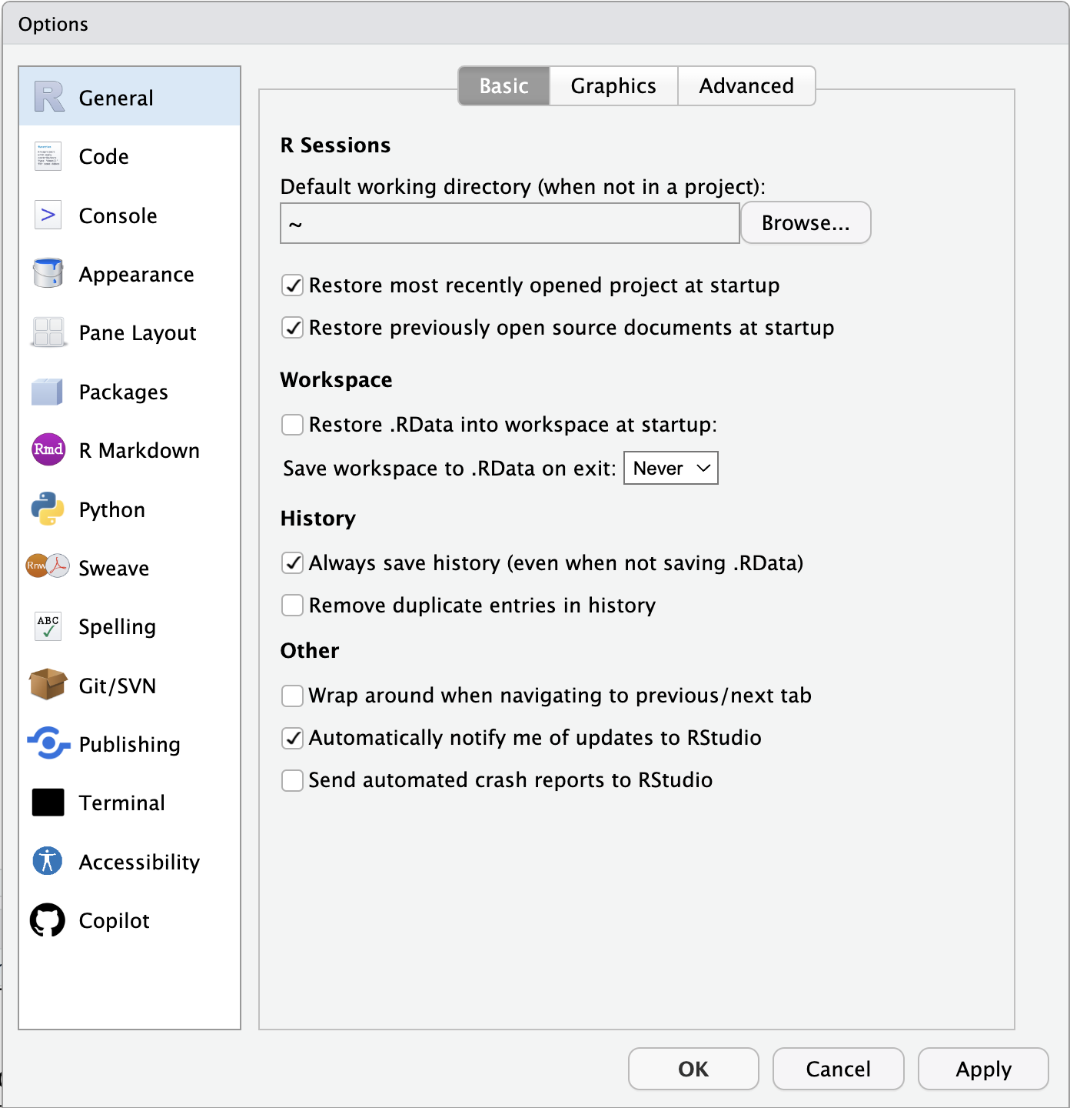
R workspaces
Turn off default saving/restoration of workspace
Edit → Settings…
Turn off “Restore .Rdata into workspace at startup”

Slide 36
STOP AND CODE
Use R to do the following. Using your ‘Lecture2_script.r’ answer the following. Remember to save & comment ‘#’ your work:
1) 1 + 2(3 + 4)
2) ln(4³+3²⁺¹)
3)
4)
Try running these!

Slide 37
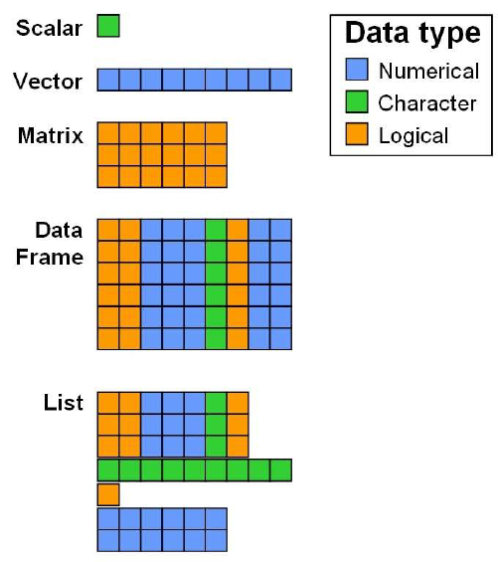
Objects
Every programming outcome in R can be stored as an object
Numbers
Characters (i.e. text or strings)
Tables
Vectors and matrices
Plots
Statistical output
Functions
Good names for objects are critical
Objects in R are global
Notes:
Go into dataframes here and adding in columns

Slide 38
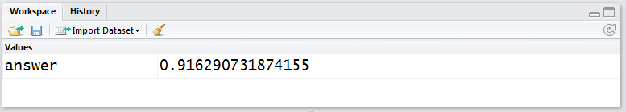
Assigning values
# Assign the result of log(2.5) to a new object called “answer”
answer <- log(2.5)
answer = log(2.5)
answer <- log(2.5, base=10)
# = can be used instead of <- but is frowned upon; # YUCK!!!
# optional argument
When you run this command, an object “answer” is created in the workspace that is assigned the value of 0.91629… In RStudio, the workspace window lists all the objects in the current workspace

Slide 39
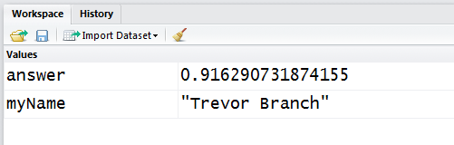
Assigning values
# Characters can also be assigned to objects
myName <- "Trevor"
myName <- 'Trevor'
> (myName <- "Trevor Branch")
[1] "Trevor Branch"
# Usually we use double quotation marks, but # single quotes are treated the same
# Surrounding a command in ( ) will display
# the assigned value in the R console; Can include spaces

Slide 40
Viewing objects
RStudio: just look at the top-right Workspace tab
Alternatively (and more generally):
> print(answer)
[1] 0.9162907
> answer
[1] 0.9162907
> answer * 10
[1] 9.162907
# Very general command, works on everything
# Manipulate the value contained within the object

Slide 41
Removing objects
# To find a list of all objects in the workspace
> ls()
[1] "answer" "myName"
# To remove an object
> rm(answer)
> ls()
[1] "myName"
To remove all objects
> rm(list = ls())
> ls()
character(0)
Nothing left in workspace
Notes:
Removing all objects you can use rm(); you don’t need to code this but
Useful for clearing your workspace at the start of a new session

Slide 42
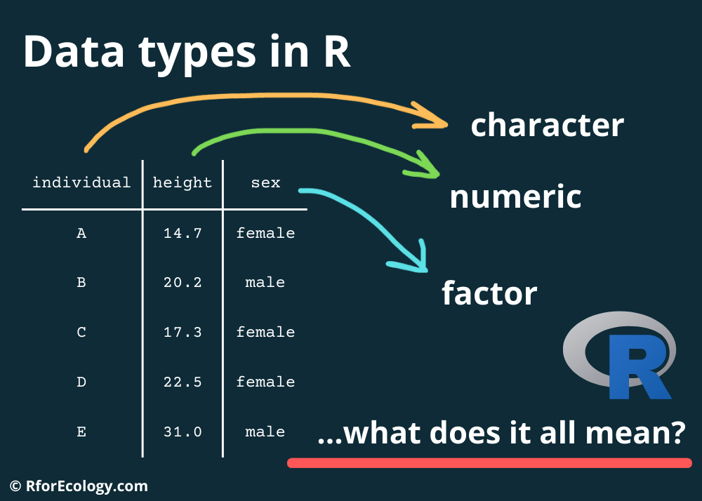
Today’s presentation
Introduction to R Programming Language
Structure of R
Installation and set-up
Data-types in R
Working with dplyr

Slide 43
Data types
Data types describe how objects are stored in computer memory
In R, you do not need to specify the data type
Common data types (also known as mode) include
Numeric (integer, floating point numbers or doubles)
Logical (Boolean, true or false)
Characters (text or string data)
The object type is not always obvious in R, and knowing what it is can be important

Slide 44
Finding data types??
> answer <- log(2.718282)
> answer
[1] 1
# Is it numeric or text?
> mode(answer)
[1] "numeric"
# Part of a family of is. functions
> is.numeric(answer)
[1] TRUE
Specifically, what type of object is it?
> typeof(answer)
[1] "double”
The as. functions coerce objects from one type to another
> answer <- as.integer(answer)
> typeof(answer)
[1] "integer"

Slide 45
Everything is a vector
Vectors are the most basic unit of storage in R
Vectors are ordered sets of values of the same type
Numeric
Character (text)
Logical (TRUE or FALSE)
Date etc…
10 -> x
x is a vector of length 1 with 10 as its first value

Slide 46
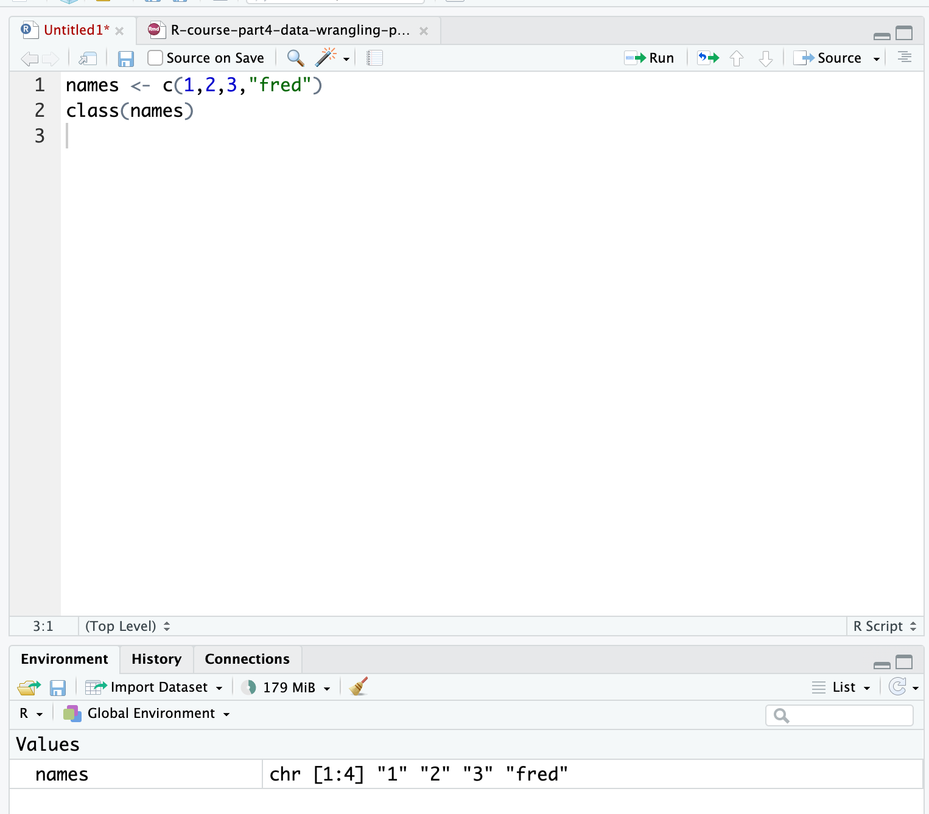
Creating vectors manually
#Use the c (combine) function
#Data must be of the same type
c(1,2,4,6,3) -> simple.vector
c("simon","laura","sarah","jo","louise") -> some.names
names <- c(1,2,3,"fred")
[1] "1" "2" "3" "fred"
Question: What was the class of the object ‘names’?
Notes:
Single value is equivalent to c(value)

Slide 47
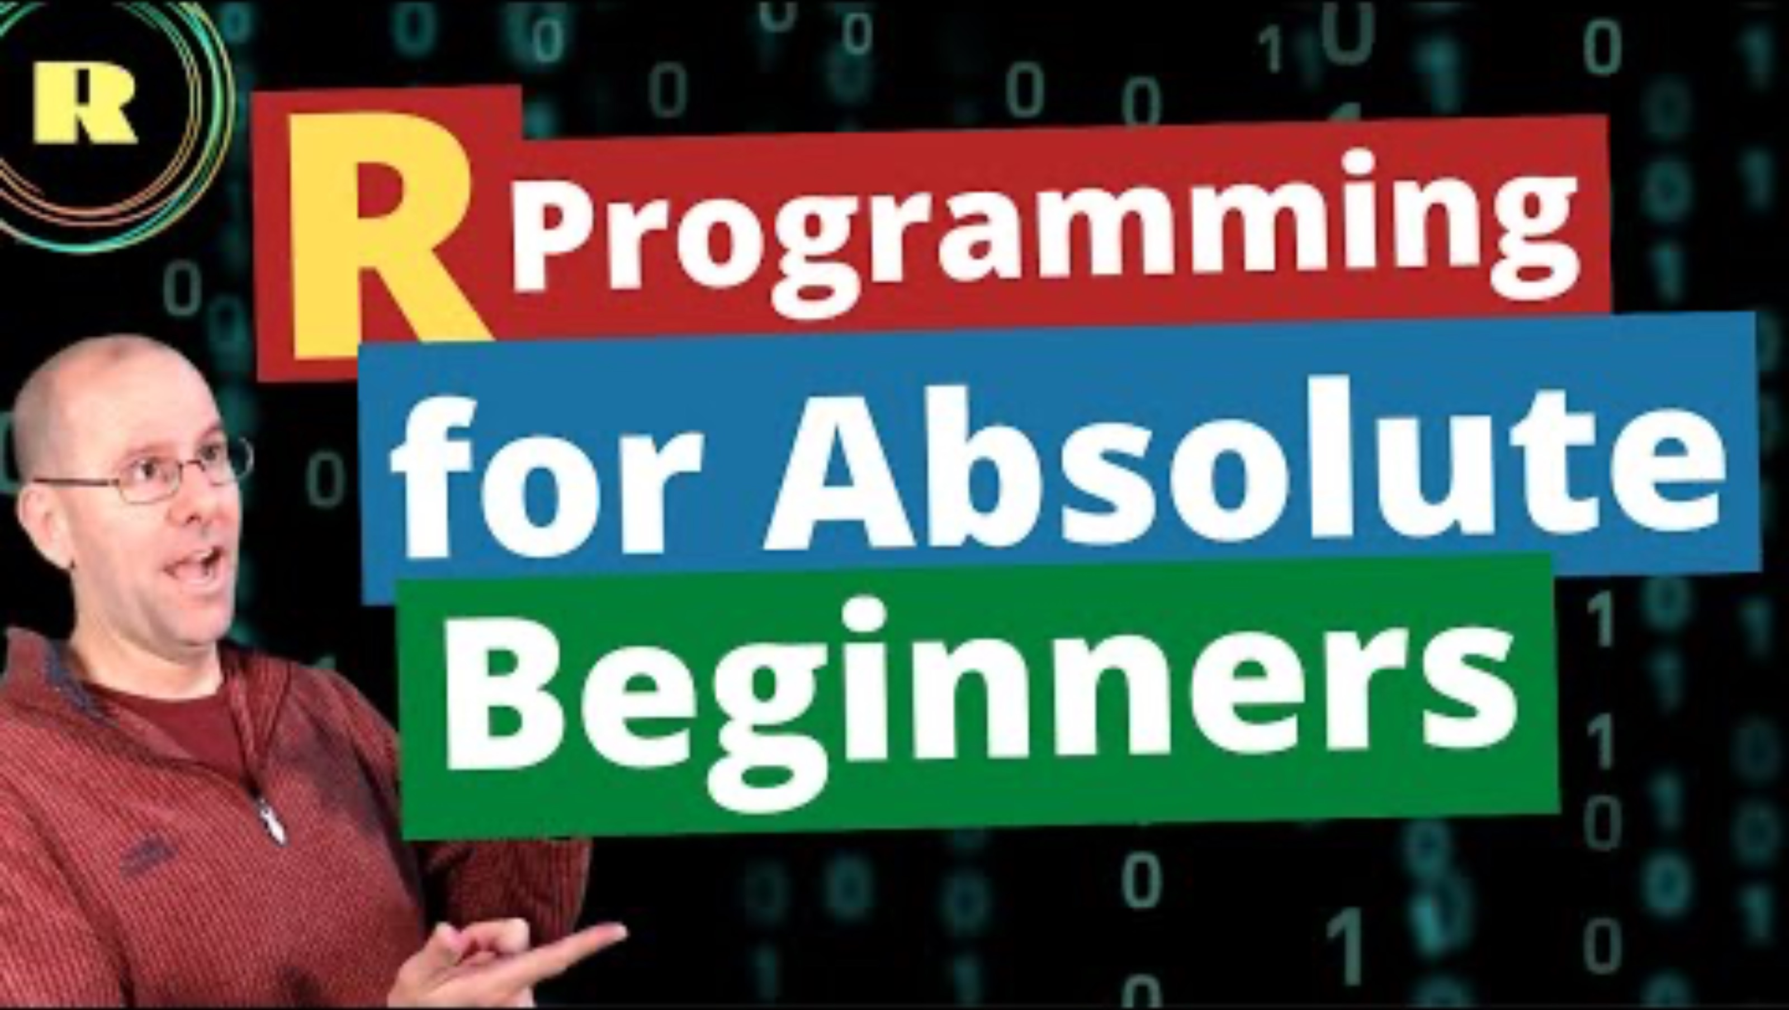
Catching up on the basics
If this was a lot just take a look at this video for some extra practice:

Slide 48
Data Frames and Lists
Multivariate data consists of multiple data vectors considered as a whole.
We’re free to work with our data as separate variables, but it can behoove us to combine related vectors into a single object such as a data frame, which is used to store a rectangular grid of data.
Usually, rows correspond to experimental units/subjects, and columns correspond to variables/measurements.
All column lengths are the same.
A list is a more general storage object which is comprised of a collection of components
Size of the objects can differ.
Anything goes in terms of structure!

Slide 49
Examples of Both
Data frame: Any one of the various data sets we will be using
List: Typically the output of a function. E.g., consider the object
Dhf = density(iris$Sepal.length)
We can check that Dhf is a list via summary(Dhf), which tells us each component and gives its data type.

Slide 50
Creating a Data Frame or List
#Data frames are created with data.frame(). E.g.,
x<-1:2
y<-letters[1:2]
z<-1:3
data.frame(x,y)
data.frame(x,y,z) #error due to unequal lengths
#Lists are created with list(). E.g.,
list(x,y,z) #unnamed components
list(x.name=x,y.name=y,z.name=z) #named components

Slide 51
Accessing Values in a Data Frame
# Can access values with either the name of a column or with row column notation
DF <- data.frame(x,y)
DF$x #access x column of DF
DF$[,’x’] #access column named x
DF$x[1] #access first entry in column x of DF
DF[1,2] # access entry in first row, second column

Slide 52
Accessing values in a list
#If list components are unnamed, use double-bracket notation [[]].
lst = list(x,y,z)
lst[[1]] #access first component x
#If components are named, access using $comp.name.
lst.named = list(x.name=x, y.name=y, z.name=z)
lst.named$x.name
names(lst.named)
lst.named[['x.name']]
For both data frames and lists, can edit values or components by accessing them and reassigning them, or using edit(obj).

Slide 53

Today’s presentation
Introduction to R Programming Language
Structure of R
Installation and set-up
Data-types in R
Working with dplyr

Slide 54
Data manipulation with dplyr

Slide 55

But first…. We use pacman to load and upload packages
What is pacman???
Combines and simplifies base R package functions with p_xxx commands
Speeds up workflows and reduces code when added to .Rprofile
p_load() loads and installs missing packages in one step
Most functions don’t require quotes around package names
Ideal for scripts, teaching, and sharing reproducible code

Slide 56
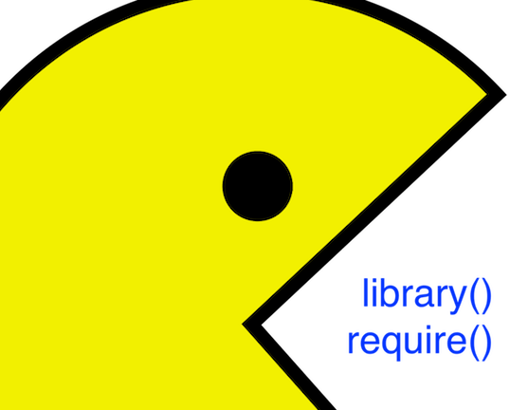
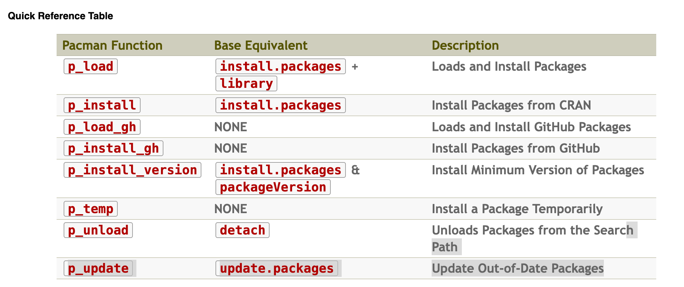

Install pacman
#Install pacman if not already installed
install.packages("pacman")
#Now use p_load() to load dplyr and nycflights13 (installs if missing)
pacman::p_load(dplyr, nycflights13)
# you will now use the function p_load() and any package at the start of all of your scripts!

Slide 57

dplyr and Tibbles
dplyr Contstrains options, helps one think about data manipulation challenges.
Provides simple “verbs”, functions that correspond to common data manipulation tasks
Works efficiently and quickly
Utilizes objects known as tibbles, which can be thought of as modernized data frames
E.g., flights (nycflights13) is saved as a tibble object
To convert a data frame to a tibble, use as_tibble()

Slide 58
Single Table Verbs
dplyr aims to provide a function for each basic task of data manipulation.
As in base R, all the output of all of these functions can be stored as an object in the workspace.
filter() | Select cases based on their values
arrange() | Reorder based on values of a variable
select() and rename() | Select variables based on their names.
mutate() and transmute() | Add new variables that are functions of existing variables.
summarise() | Condense multiple values to a single value
sample_n() and sample_frac() | Take random samples.

Slide 59
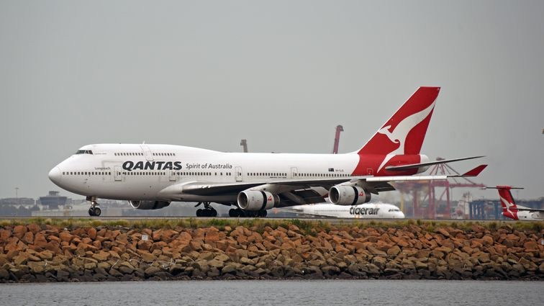
Data: nycflights13
We’ll explore all this through the example of the flights (nycflights13) data set, which contains info on all 336,776 flights that departed from NYC in 2013.
Install the package.
install.packages(nycflights13)
library(nycflights13)
flights #inspect data set
Stop and check
Is flights a data frame or a list?
How many columns are there?
How many rows?
how many columns are numeric?

Slide 60
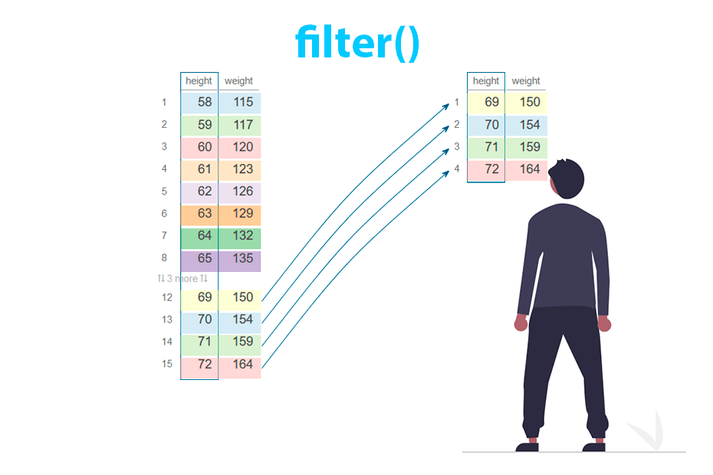
filter()
filter() allows us to select a subset of a tibble. The first argument is the tibble object, and the subsequent arguments are logical expressions for the data, separated by commas.
The function returns all data for which all logical statements are TRUE.
# E.g., select all flights on January 1st:
filter(flights, month==1,day==1)
Roughly equivalent to R-base code
flights[flights$month==1 & flights$day==1]… Yuck
When using dplyr functions, do not need to use attach() or $ notation.

Slide 61
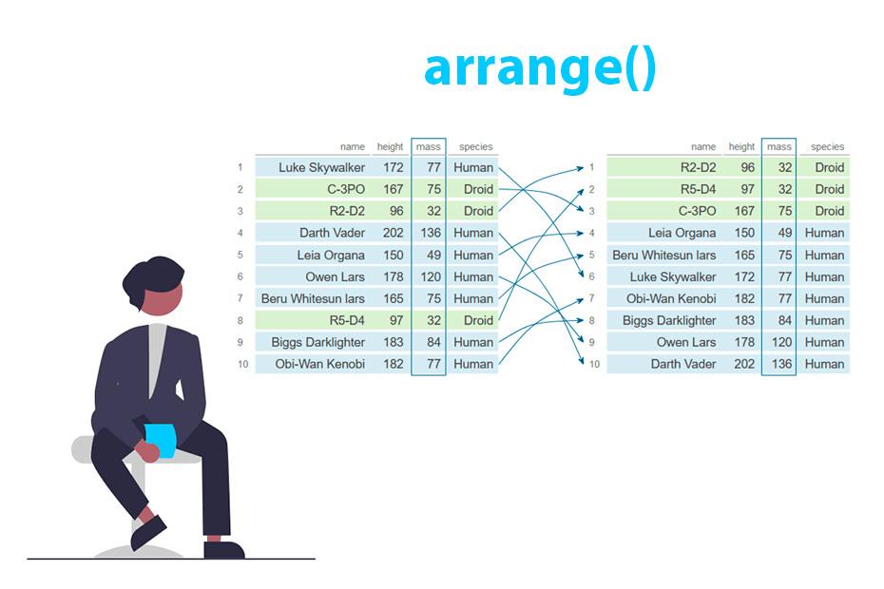
arrange()
arrange() works similarly to filter(), except that it reorders rows according to the ordering of one or more particular variables instead of subsetting them.
First argument is the tibble, the second argument is the reordering variable, and subsequent arguments are variables that break ties of the variable immediately preceding them.
# E.g., sort by scheduled departure time (sched_dep_time), using departure delay (dep_delay) # to break ties:
arrange(flights, sched_dep_time, dep_delay)
# Use desc() on one of the reordering variables to sort by descending # order of that variable:
arrange(flights, desc(sched_dep_time), dep_delay)
Can reorder by as many variables as you like!

Slide 62
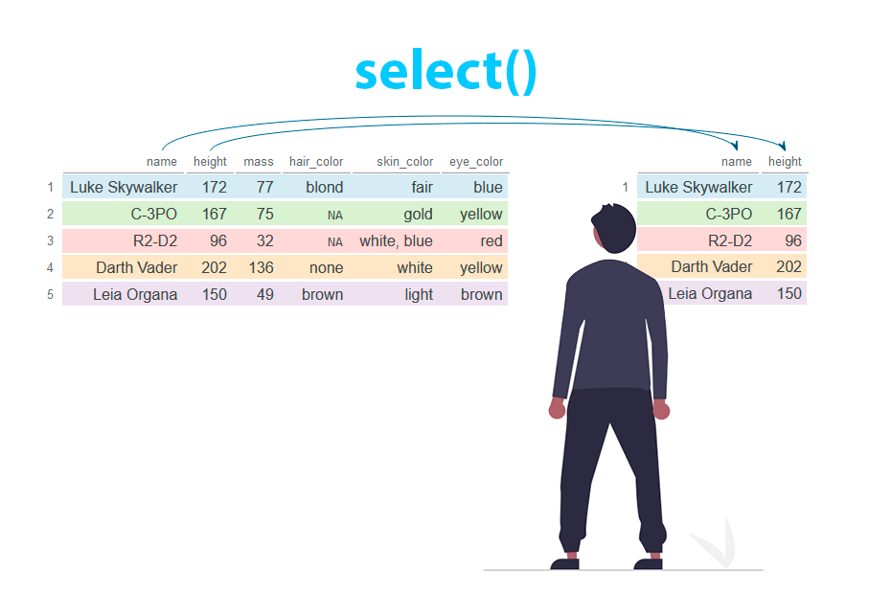
select() and rename()
select() allows us to subset the data by selecting the columns/variables that we’re interested in. As before, the first argument is the tibble, and the subsequent arguments are the variables we wish to select.
# select only date-related variables (year, month, day):
select(flights, year, month, day)
#select all variables between year and day, inclusive
select(flights, year:day)
# select all variables except date-related variables:
select(flights,-(year:day))

Slide 63
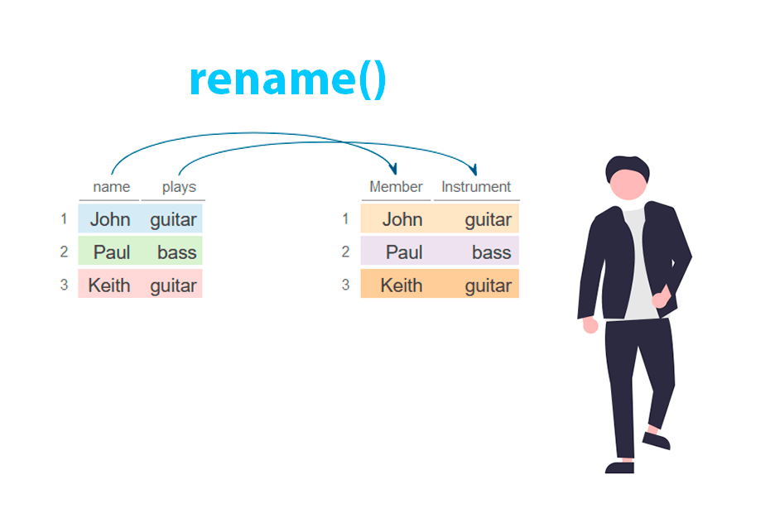
select() and rename()
Can also use select() to rename variables.
Syntax is select(tibble, new.name = oldname).
# E.g., variable name tailnum doesn’t match style of other # variable names, so change it to match style:
select(flights, tail_num = tailnum)
However, doing this produces a tibble with only the variable in question and drops the rest.
# Function rename() renames variables without dropping # the rest. Syntax is the same:
rename(flights, tail_num = tailnum)

Slide 64
distinct()
Helps extract unique values from a variable.
Syntax: distinct(dataset,by=column1)
# E.g., variable name tailnum doesn’t match style of other # variable names, so change it to match style:
select(flights, tail_num = tailnum)
However, doing this produces a tibble with only the variable in question and drops the rest.
# Function rename() renames variables without dropping the rest. # Syntax is the same:
rename(flights, tail_num = tailnum)

Slide 65
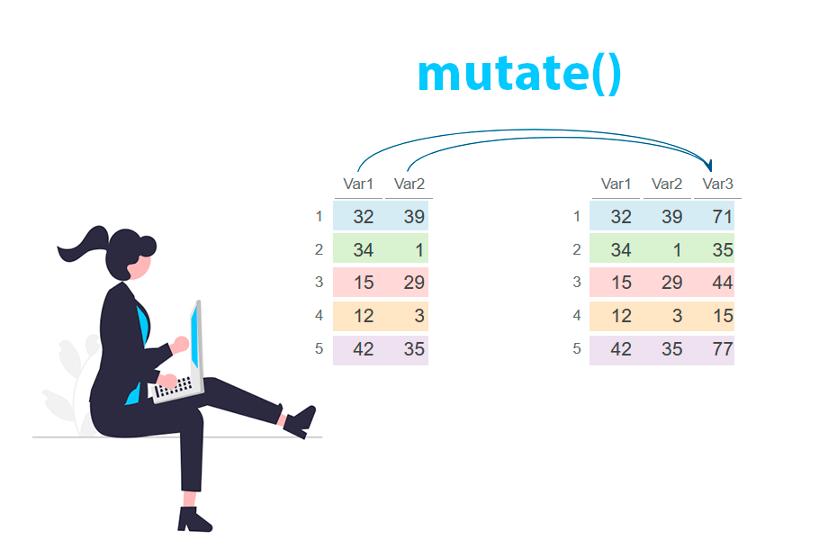
mutate() and transmute()
mutate() adds new columns that are functions of existing columns.
Syntax: mutate(tibble, new_var = func_old_vars)
# E.g., add gain variable that gives amount of time exceeding scheduled time in the # air, and speed variable in mph:
mutate(flights,
gain = arr_delay - dep_delay,
speed = distance/air_time * 60)
Hard to see right? What function could you add to see the data frame?
Subsequent new variables in the same command can refer to previous new variables created.
If you only want to keep the new variables use transmute() with the same syntax.

Slide 66
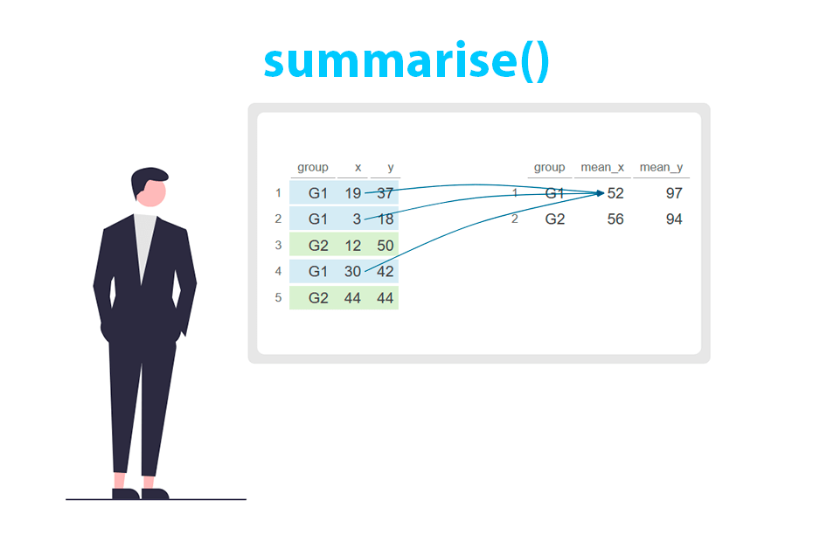
summarise()
Collapses data frames to a single row.
Syntax is summarise(tibble, entry_name=function)
# E.g., determine mean and standard deviation of departure # delay (dep_delay):
summarise(flights,
mean_dep_delay = mean(dep_delay, na.rm=T),
sd_dep_delay = sd(dep_delay, na.rm=T))
Alone this is useless until we touch upon the group_by() function.

Slide 67
group_by()
Groups data set into multiple subsets.
Syntax is group_by(tibble, grouping_var).
The resulting tibble includes the grouping variable in the tibble heading with the number of groups.
# E.g., group flights data by tail number (tailnum):
by_tailnum = group_by(flights, tailnum)
summarise(by_tailnum,
mean_dep_delay = mean(dep_delay, na.rm=T),
sd_dep_delay = sd(dep_delay, na.rm=T))

Slide 68
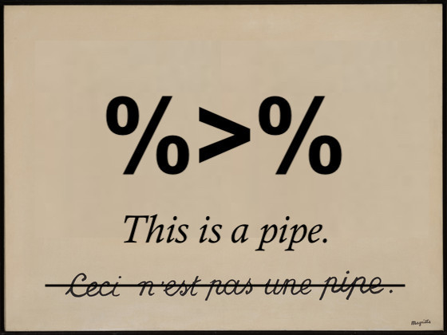
Stringing together multiple dplyr commands… THE POWER OF PIPES
All of these functions work fine on their own. But if we want to string together multiple dplyr commands and result in one tibble, we have to save our objects at each step of the way.
# create a flights tibble that displays only average departure and arrival delays for # days on which either of those averages are greater than 30 minutes:
A1 = group_by(flights, year, month, day)
A2 = select(A1, arr_delay, dep_delay)
A3 = summarise(A2, arr = mean(arr_delay, na.rm = T),
dep = mean(dep_delay, na.rm =T))
A4 = filter(A3, arr > 30 | dep > 30)

Slide 69
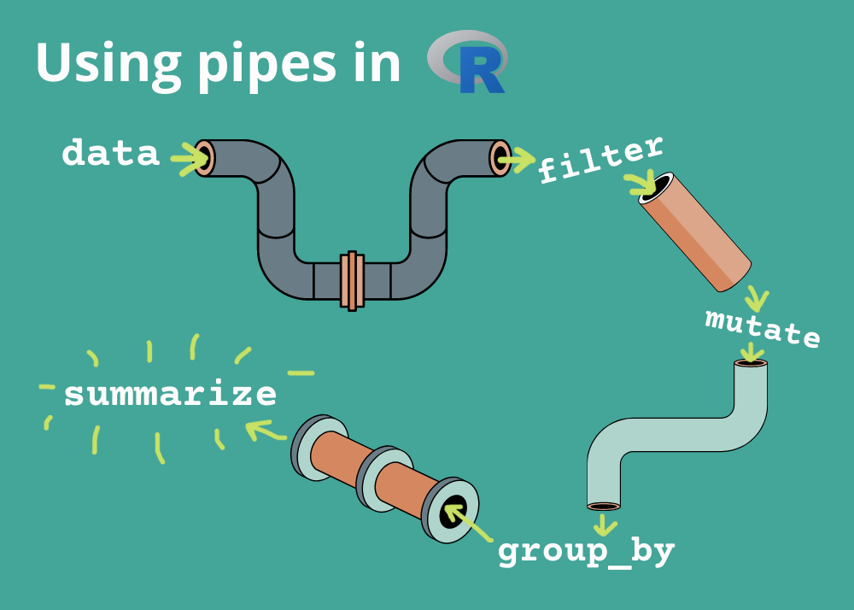
Stringing together multiple dplyr commands… THE POWER OF PIPES
What’s a pipe? A forward‐pipe operator that passes the output of one expression as the first argument to the next.
Why use pipes?
Makes code linear and readable
Eliminates nested function calls
Encourages stepwise data transformation
Key package: %>% comes from magrittr (and is re‐exported by dplyr, tidyverse, etc.)
Notes:
What’s happening here:
group_by(year, month, day) — groups by date
select(arr_delay, dep_delay) — keeps only the two delay columns
summarise(...) — computes the daily mean arrival and departure delays (dropping the grouping when done)
filter(arr > 30 | dep > 30) — keeps only those days where either mean delay exceeds 30 minutes

Slide 70
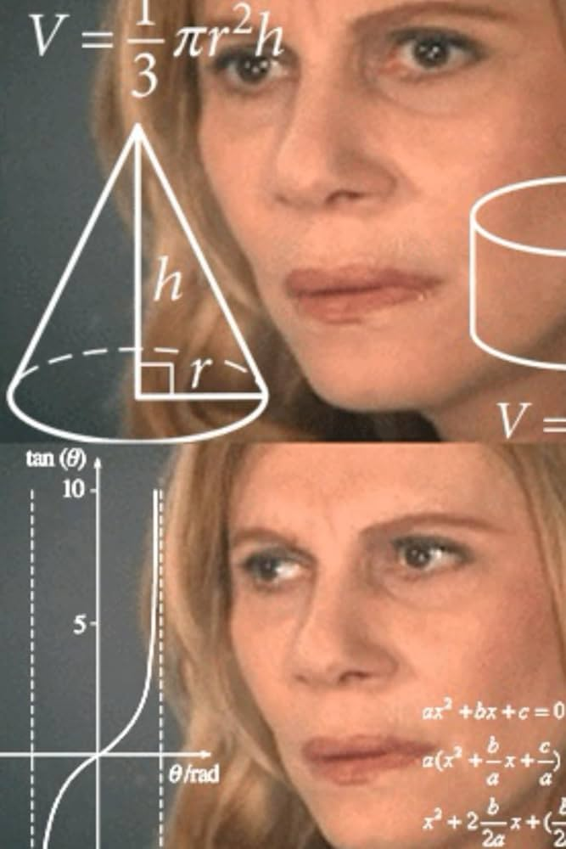
Stringing together multiple dplyr commands… THE POWER OF PIPES
All of these functions work fine on their own. But if we want to string together multiple dplyr commands and result in one tibble, we have to save our objects at each step of the way.
# create a flights tibble that displays only average departure and arrival delays for # days on which either of those averages are greater than 30 minutes:
A1 = group_by(flights, year, month, day)
A2 = select(A1, arr_delay, dep_delay)
A3 = summarise(A2, arr = mean(arr_delay, na.rm = T),
dep = mean(dep_delay, na.rm =T))
A4 = filter(A3, arr > 30 | dep > 30)
This will clutter up your environment

Slide 71
Stringing together multiple dplyr commands
Alternatively, we can write each command within the subsequent command:
# E.g., from the previous slide:
flights %>%
group_by(year, month, day) %>%
select(arr_delay, dep_delay) %>%
summarise(
arr = mean(arr_delay, na.rm = TRUE),
dep = mean(dep_delay, na.rm = TRUE),
.groups = "drop") %>%
filter(arr > 30 | dep > 30)
flights data frame
↓ group_by()
↓ select()
↓ summarize()
↓ filter()
Notes:
What’s happening here:
group_by(year, month, day) — groups by date
select(arr_delay, dep_delay) — keeps only the two delay columns
summarise(...) — computes the daily mean arrival and departure delays (dropping the grouping when done)
filter(arr > 30 | dep > 30) — keeps only those days where either mean delay exceeds 30 minutes

Slide 72



Using AI
Think of AI as…
A “calculator for words” – it predicts the next token based on context, so more detail = better result.
A paired programmer – don’t expect perfection up front; break problems into steps, discuss your approach, then iterate.
Iterate & Refine
Share your errors or unexpected outputs
Explain “this is what I got vs. what I expected” to help the AI self-correct
At the end of the day if you don’t know the ‘R language’… Don’t expect AI to solve your problems

